Slide 1
Caesar Ciphers
Nam Nguyen

Slide 2
What is Caesar Ciphers?
What is Encryption?
-Encoding a message or information in such a way that only authorized parties can access it.
But Why?
+Prevent Interference
+Secure Information

Slide 3
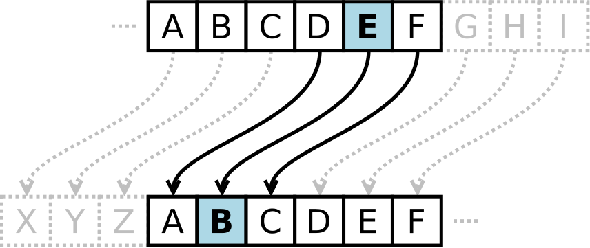
Concept of Caesar Cipher

Slide 4
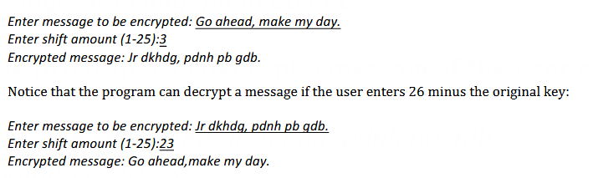
Example:

Slide 5
What is Caesar Ciphers?
Pros:
- No complicated techniques required
-Few Resources used
-Short key
Cons
-Simple
-Minimum Security
-Frequency in the Letters make it very easy to crack

Slide 6
Improvement
Use Psedo-random Shift Algorithms
+Receivers are given a passcode to decrypt
Dummy word implemented
+The chosens Letters won’t be shifted
+Independent from random Shift
-> 2 step Encryptions
-> Theoretically imposible to Decrypt unless without all passcode, or you are the receiver.
+Distraction in the passcode to throw people off, if by any chances they are able to obtain from the user.

